Slide 1
Body Paragraphs

Slide 2
Body Paragraph(s)
Each paragraph is about a subclaim from your thesis statement. 3 subclaims = 3 body paragraphs)
Each paragraph should have intro to evidence & evidence/explanation that supports your thesis statement. (i.e. quotes, facts, etc.)
Example Thesis: The best vacation spot in the US is Las Vegas because of the shows and attractions, the nice weather year round, and its affordability.
What would your 3 body paragraphs be about?
Made up of the following:
Topic Sentence
Transitions
Intro Evidence/Evidence
Explanation
Concluding Sentence

Slide 3
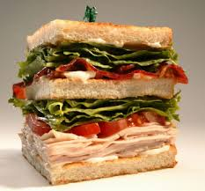
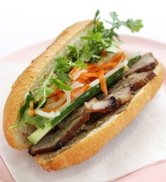
Body Paragraphs
Top bun = topic sentence
Condiments (sauce) = transitions
Meat =intro to evidence/evidence
Veggies = explanation
Bottom bun = concluding sentence
Think of a body paragraph as a SANDWICH!
Top Bun
Sauce
Meat
Veggies
Bottom Bun

Slide 4
Topic Sentence
It is a mini thesis!
It tells us what your entire paragraph is going to be about. Which should be one of your subclaims!
It states the topic/prompt and your subclaim.
It is the first sentence in your paragraph.
Thesis
Mini thesis AKA topic sentence
Example: Las Vegas is the best vacation spot because of it’s shows and attractions.

Slide 5
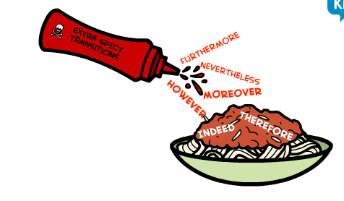
Transitions (means change)
Words that help us know you are going to start talking about something else – while still relating to your topic!
Moving from one idea to another
Examples:
Since
Therefore,
In conclusion,
Although
Even though
However,

Slide 6
Introducing Evidence
The information/context you give before you give your evidence (quote, etc.).
4 ways to introduce a piece of evidence:
#1. Begin a sentence with your own words then complete it with quoted words. (The man knew he had made a mistake when she said, “I should have listened to the old timer on Sulphur Creek”)
#2. Quote an author by naming the source followed by a comma. (In the book To Kill a Mockingbird, )
#3. Use a descriptive verb followed by a comma (Johnson states/explains/responds, etc.)
#4. Give context of the text (Before Walter Mitty has his first day dream he is driving around town running errands with his wife . . . )
You CANNOT simply put a quote without introducing it.
It makes it feel RANDOM and UNINTENTIONAL!

Slide 7
Evidence
What you are using to prove your point. Evidence must be cited properly. Example of citation: (Reyes 5)
Types of evidence:
Stories
Summaries
Interviews
Articles
Videos
Songs
Quotes - THAT IS THE MOST COMMON! And what we will be focusing on.
Etc.
Author last name
Page number

Slide 8
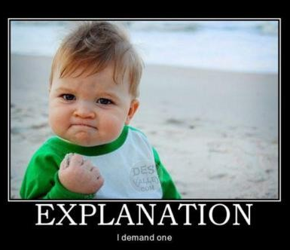
Explanation
Just like the name suggests, explanation just means you explain to the reader why the evidence you are using proves your point.
You CANNOT assume your reader should just understand why you are using the evidence you are to make your point – explain it to them!

Slide 9
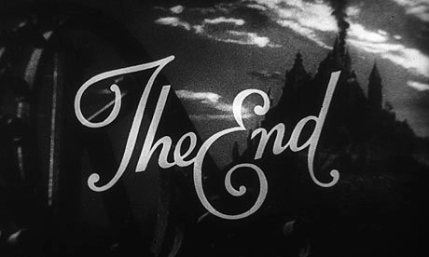
Concluding Sentence
Summarizes or restates the main idea expressed in the topic sentence.
Last sentence in your paragraph

Slide 10
Label the 5 parts of a paragraph with this example paragraph:
Las Vegas is the best vacation spot because it has many shows and attractions. One of the best shows in Las Vegas is Cirque du Soleil. It is one of the most recognized shows in the world and is known for “its incredible acrobatic feats, which are performed with an unrivaled level of artistry” (Anderson 1). People come all over the world to see the talented artists at Cirque perform because there is no show quite like it. In addition, there is also dancing available because there are many clubs to choose from. Heather Carroll in her article titled, “The Best Dance Clubs in Las Vegas,” states that because “there is such a variety of dance clubs in the area, people are sure to find a dance club they enjoy” (1).The great variety of clubs helps those who like a specific type of music like country, jazz, and hip hop be able to find something they’ll enjoy. However, if people want something more family friendly to do they can go see the dolphin habitat at the Mirage. Tourists rave about the habitat because it gives them the opportunity to “get up close and personal with dolphins” (Hansen 3). Not only do people get to see the dolphins up close, but they also have the option to interact with them if they want to. Because of the variety of things to do, Vegas it is a great place to visit.
Underline & label TS
Circle & label transitions
Box around introduction of evidence & brackets around the evidence
Squiggly line & label under the explanation
Underline & label concluding sentence

Slide 11
Transitions
Transition Cheat Sheet
(highlight & comment)
Transition Story
Create a story using transitions

Slide 12
Introducing Evidence
Introductory Phrases

Slide 13
What are they? Why do we need them?
They are words or phrases that introduce your evidence. Therefore, they will always go before your evidence.
We need them because they give context to your piece of evidence.

Slide 14
THE 4 WAYS TO INTRODUCE QUOTES:
1. Begin a sentence with your own words, then complete it with quoted words.
EXAMPLE: Even though the man stated that the “old timer was right,” when he told him not to travel alone, he knew it was too late for him now (London 12).
EXAMPLE: Hamlet's task is to avenge a "foul and most unnatural murder" (Shakespeare 925).

Slide 15
THE 4 WAYS TO INTRODUCE QUOTES:
2. Quote an author by naming the source, followed by a comma
EXAMPLE:
According to Smith, "[W]riting is fun" (215).
In Smith's words, " . . .
In Smith's view, " . . .

Slide 16
THE 4 WAYS TO INTRODUCE QUOTES:
EXAMPLE:
Smith states, "This book is terrific" (102).
Smith remarks, " . . .
Smith writes, " . . .
Smith notes, " . . .
Smith comments, " . . .
Smith observes, " . . .
Smith concludes, " . . .
Smith reports, " . . .
Smith maintains, " . . .
Smith adds, " . . .
3. Use a descriptive verb, followed by a comma. Avoid using says unless the words were originally spoken aloud, for instance, during an interview.
If your lead-in to the quotation ends in that or as, don't follow it with a comma. The first letter of the quotation should be lower case.
Smith points out that "millions of students would like to burn this book" (53).
Smith argues that " . . .
Smith emphasizes that " . . .
Smith interprets the hand washing in MacBeth as "an attempt at absolution" (106).
Smith describes the novel as "a celebration of human experience" (233).

Slide 17
THE 4 WAYS TO INTRODUCE QUOTES:
4. Give context of the text (story, article, etc).
EXAMPLE:
In “A Rose for Emily,” Emily has purchased rat poison but doesn’t disclose what it is for even when the druggist asked. “Miss Emily just stared at him, her head titled back in order to look him eye for eye, until he looked away and went and got the arsenic and wrapped it up” (Faulkner 4).

Slide 18
Remember IN-TEXT CITATIONS
To do proper in-text citation
Author’s last name
Page number
Example:
“I thought I saw my husband turning from me”(Miller 974).

Slide 19
Practice Introducing Evidence
Example Thesis: The best vacation spot in the US is Las Vegas because of the shows and attractions, the nice weather year round, and its affordability.
Author is Ana Morris
Page 5
Article title is “Why Break the Bank on Vacation”
Quote: “Vegas is the home of many hotels ranging from luxury to extremely affordable.”
Write a body paragraph about affordability in Las Vegas where you practice incorporating the 5 things you need for a good body paragraph.
***REMEMBER to introduce this evidence in one of the four types of ways we discussed. Cite appropriately!

Slide 20
Turn in Introducing Evidence Notes
You will get them back ☺

Slide 21
Color Code your body paragraphs
Topic Sentence (TS) – red
Transitions – orange
Intro Evidence – green
Evidence (quotes) – black
Explanation – blue
Concluding sentence – purple

