Slide 1
Conclusion and mla format

Slide 2
What is a conclusion?
Definition: A conclusion paragraph wraps up what you have been discussing in your paper.
Your conclusion must:
1. Restate your thesis
2. Answer the “So What?” question (why your topic matters!)
3. And have a call to action

Slide 3
Restate thesis
You restate your thesis
(or say it again) but not in the
same exact words.
Still have your subclaims in order though!
Example: Dogs are better than cats because they keep you active, you can teach them tricks, and they are very loyal.
Although many people believe cats are better than dogs that is not the case. People with dogs are prone to do more outdoor activities which will help them stay active. You can also teach dogs tricks which is something you can’t do with cats. And finally, dogs are loyal and willing to be by your side no matter what.

Slide 4
Your turn. . .
Each group of four received a number that corresponds to a thesis statement.
You must find a way to reword the thesis!
Be prepared to share with the class.
Example: Dogs are better than cats because they keep you active, you can teach them tricks, and they are very loyal.
Although many people believe cats are better than dogs that is not the case. People with dogs are prone to do more outdoor activities which will help them stay active. You can also teach dogs tricks which is something you can’t do with cats. And finally, dogs are loyal and willing to be by your side no matter what.
1.Lack of exercise makes you gain weight, increases stress, and slows your metabolism.
2. Sunshine makes you happier, increases your outdoor activities, and provides your skin with nutrients.
3. Utah is a great state to live in because it has low crime rates, has booming businesses, and has recreational activities that can be done year round.
4. Smoking has negative effects on your life because it makes you look older, increases your risk of cancer, and causes you to lose friends.
5. School uniforms are good because it is easier to get ready in the morning, you don’t have to spend money as much on clothes, and they promote equality within the student body.
6. The best winter sport is ice skating because it makes you feel majestic, is good exercise, and is fairly inexpensive.
7. Redbox is better than going to the movies because it is cheaper, you can watch multiple movies in one night, you don’t have to leave your home.
8. Italy is the best vacation spot because it has delicious food, beautiful locations, and has historical sites.
9. Halloween is the best holiday because you get free candy, you get to scare people, and you get to be creative when you create your costume.

Slide 5
SO What?
This component of the conclusion lets the reader know WHY your thesis matters
It answers the question: Why should I care?
Why should I care about your argument overall?
Why should I care about your subclaims?

Slide 6
Call to action
You as the writer ask the reader to do something with the information they have gained from reading your essay. It can be asking them to:
- Think
- Understand
- Physical Action (read, write)
- Change in some way
Example: If your thesis statement “People waste thousands of pounds of food daily” what could you ask the reader to do? What could your call to action be?
-Be more mindful of your waste
-Donate food to those in need

Slide 7
Review
Your essay must do the following:
Tell them what you are going to tell them
Tell them
Tell them what you told them
Intro: Hook & Thesis
Body Paragraphs
Conclusions

Slide 8
Example paragraphs - thesis
The best vacation spot in the US is Las Vegas because of the shows and attractions, the nice weather year round, and its affordability.

Slide 9
Example 1: What is missing? Underline restated thesis put a square around the “so what” component put a circle around the call to action component
The best vacation spot in the US is Las Vegas because of the shows and attractions, the nice weather year round, and its affordability. So many people have a hard time deciding where to go on vacation because they aren’t familiar with places that they can go to in the US which are not only fun but also affordable. That is why people should research before making their decision of where to go on vacation, otherwise they will miss the opportunity to discover places like Las Vegas.

Slide 10
EXAMPLE 2 Underline restated thesis put a square around the “so what” component put a circle around the call to action component
Although many people believe that Las Vegas is not the best vacation spot in the US it really is. You see, Las Vegas has many shows and attractions such as Cirque du Soleil, dance clubs, and a dolphin habitat. Not to mention, you can take a trip there anytime of the year since the weather is always pleasant. And finally, it is affordable to travel to Las Vegas without breaking the bank like you would in other places in the US. So many people have a hard time deciding where to go on vacation because they aren’t familiar with places that they can go to in the US which are not only fun but also affordable. That is why people should research before making their decision of where to go on vacation, otherwise they will miss the opportunity to discover places like Las Vegas.

Slide 11
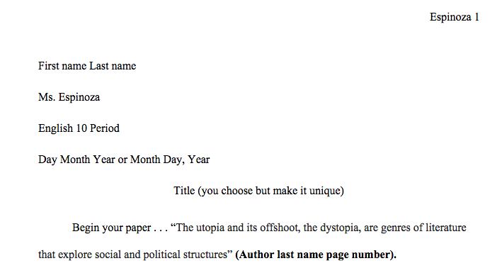
Mla format
The basics: Double spaced, 12 pt font, Times New Roman
Indent at the beginning of paragraphs!

Slide 12
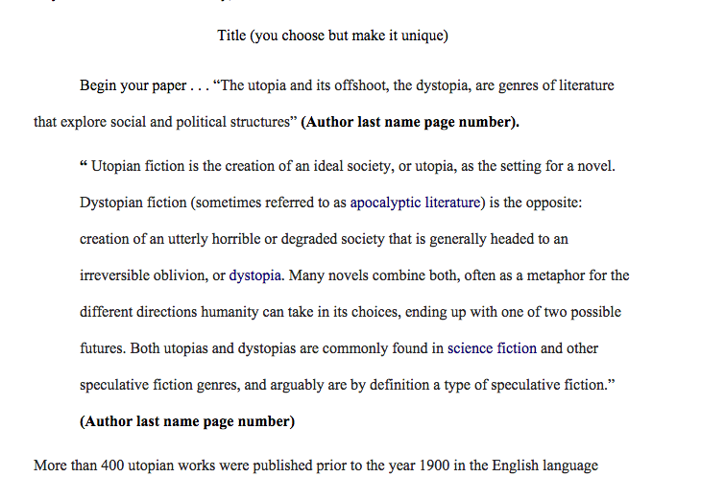
Block quote

Slide 13
Title of books/movies – italics articles in quotation marks

Slide 14
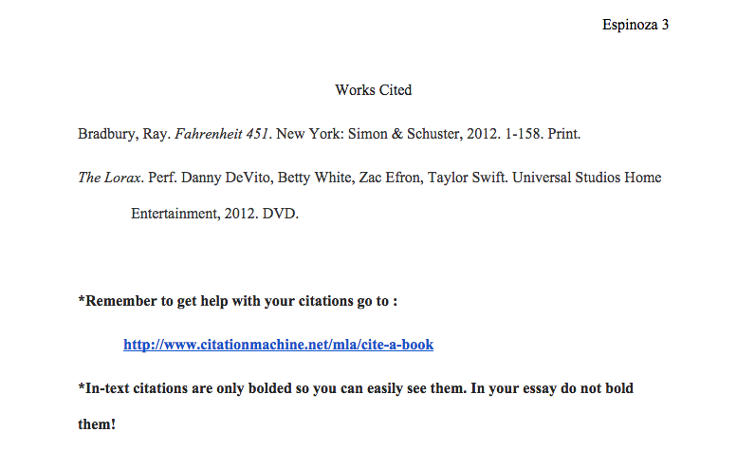
Work cited
It needs to be in alphabetical order
It needs to have proper items italicized
Page numbers if necessary
Still needs to be 12 pt. font, Times New Roman, Double Spaced
Hanging indent if more than two lines

Slide 16
MLA Format
If you need a review of what MLA looks like you can find it on my website!
Go to my website
Click on English 10 Resources
Under Term 1 & 2 you will see “Dystopian Book Clubs”
It will make you sign in to google and be under “MLA Fake Essay”

