Slide 1
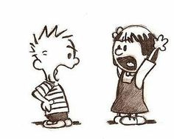
Counterclaim Paragraph

Slide 2
Choose 1
Choose one of the major points against your view point.
Example #1: Although many people believe that social media helps people by staying connected it actually hurts more than helps because it promotes body issues, induces cyber bullying, and is a major distraction.
Thesis/Claim: Social media today is hurting our society because it promotes body issues, induces cyber bullying, and is a major distraction.
Counterclaim: Many people believe that social media helps people stay connected.

Slide 3
Practice
Example #2:
Although many people believe that technology is dangerous it actually isn’t because it provides a means of communication, it helps the overall health of individuals, and it has helped people gain knowledge.
Thesis/Claim: Technology is helpful because it provides a means of communication, it helps the overall health of individuals, and it has helped people gain knowledge.
Counterclaim:Technology is dangerous (because of cyber bullying).

Slide 4
Refute or Concede?
REFUTE: You don’t agree with the counterclaim at all. It is wrong or you see a downfall or flaw in it.
CONCEDE: Sometimes you can validate the counterclaim by stating that you understand why people have that viewpoint. BUT if you do you must also convince your reader why it isn’t enough to make you join that side.
YOU NEED TO BE RESPECTFUL!

Slide 5
Refute or Concede? Which one works best for this argument?
Thesis: Although many people believe that social media is beneficial because it helps people stay connected it actually hurts more than helps because it promotes body issues, induces cyber bullying, and is a major distraction.
It is true that social media can help people stay connected. However, in recent studies it has been shown that 8/10 people have actually felt disconnected with their loved ones because of social media. People argue that social media helps people stay connected with individuals, however that is not the case.
Always use the one that best works for your argument!

Slide 6
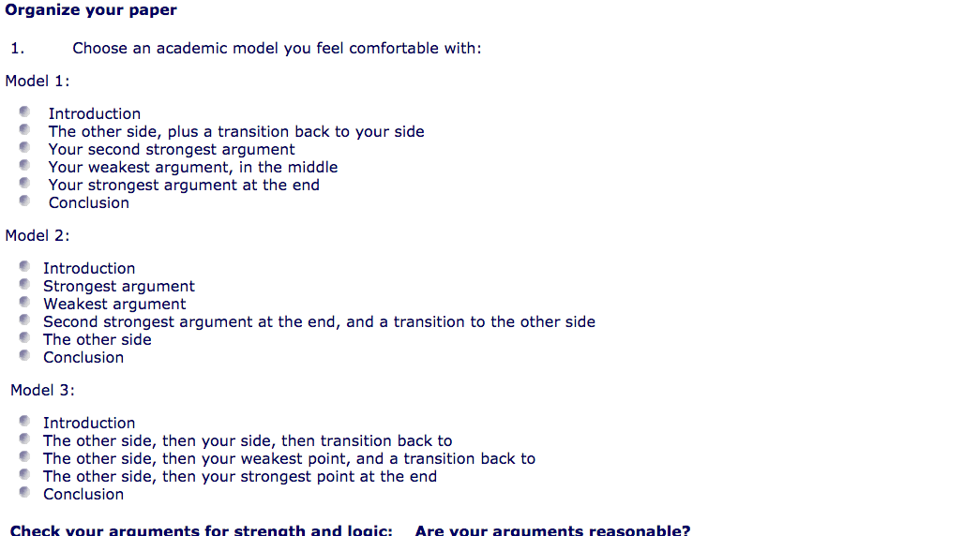
Models of argument essays

