Slide 1
3 Types of Introductions

Slide 2
What is an introduction?
It starts off your essay! It should get the readers attention (hook) while also letting us know what the entire paper is going to be about (thesis)
Introductions are composed of the following, in this order:
1. HOOK
2. THESIS

Slide 3
Take some notes!
Today we are going to be talking about three types of introductions
These are not the only ones out there, but they will help give you a framework for future papers.
If you ever get stuck on how to start your paper – use any of these three intros to help you ☺

Slide 4
Thesis: Rats make wonderful pets because they provide companionship, they are not difficult to take care of, and they are inexpensive. .
We will be talking about three specific types of introductions.
Inverted triangle
Narrative
Interrogative
The examples of these types of introductions are going to be based on the thesis statement above.

Slide 5
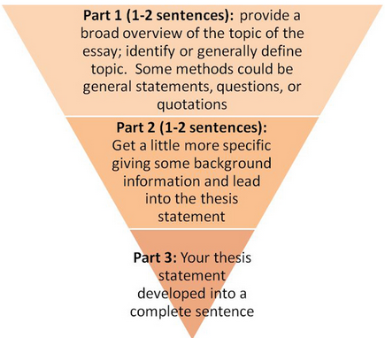
#1. Inverted Triangle
Definition: Moving from a general topic to a specific thesis.
Hint:
Can start with a startling fact about your topic! (Example: The average American drinks 600 sodas a year.)
OR
Simply discussing the topic and its importance.

Slide 6
Think of . . .
Your favorite ANIMAL
Mammals
Ocean mammal
Dolphins
Bottle nose dolphins
Your favorite FOOD
Green Chicken Enchiladas
Chicken Enchiladas
Enchiladas
Mexican
From BROAD
.
.
.
.
To SPECIFIC
From SPECIFIC
.
.
.
.
To BROAD

Slide 7
Example of Inverted Triangle Intro
Dogs, cats, fish, and birds constitute what most folks consider the best of domestic pets. A loyal and friendly dog, or a tolerant and moody cat can bring genuine companionship and personality to a home. While these pets remain the status quo when it comes to domesticated animals, lizards, snakes, frogs, and even pigs have also been domesticated. Pet stores sell all sorts. But why are dogs and cats the focus? Perhaps it is because of the track record of their even temperament. Perhaps it is a tradition of “that’s-just-what-you-get” when it comes to pets. But what about the atypical animals? What about, say, rats? Although the word rodent or rat has definite negative connotations—connected to the plague or to disease or to sewers, etc.—the positive aspects associated with these creatures is, like most other animals, pleasant. Even healthy. Research and plenty of experience has shown that rats make wonderful pets because they provide companionship, they are not difficult to take care of, and they are inexpensive.

Slide 8
In the example paragraph on your paper I want you to…
Underline what part of it was BROAD or general information
Circle what part of it was getting a little bit more specific – hinting at the topic it is going to discuss
And put a square around what the most specific part of it was – so the thesis!

Slide 9
#2. Narrative Introduction
What does narrative mean: A STORY!
Start with a story (fiction/nonfiction)
that relates to your topic/thesis
Thesis statement

Slide 10
Example of Narrative Introduction
When 44-yr-old Sheryl Johnson realized she was going to have to work late, she called her neighbor, Sibyl Brown-Wallace, who had a key to Johnson’s apartment. Johnson needed her neighbor to check on her pet who had been inside all day. “Go see Pepper,” Johnson told her neighbor. “He needs to be let out.” Brown-Wallace was both accustomed to the request and happy to do it. Pepper, it turns out, is Johnson’s domesticated, hygienic, black-and-white, male rat. Pepper stays in a cage while Johnson is at work. “He’s happy enough with food and drink in the cage, but he is happiest when he is out, roaming the living room,” says Johnson (Currier 2). Sheryl Johnson learned long ago that rats, just like any other household pet, can offer the companionship and loyalty that a cat or dog can offer. Johnson knows rats make wonderful pets because they provide companionship, they are not difficult to take care of, and they are inexpensive.

Slide 11
In the example paragraph on your paper I want you to…
Circle what part of it was a narrative.
And put a square around the thesis.

Slide 12
#3. Interrogative Introduction

Slide 13
Example of Interrogative Intro
Why do humans domesticate animals? Why do they feel a burning need to buy, groom, dress up, name, and get their family pictures taken with their pets? Pets seem to bring quality to people’s lives and purpose to their everyday schedules. But not any pet will do. Many believe that when it comes to pets some are better than others. The typical pets which people commonly prefer include cats, dogs, and fish. However, as unusual as it may sound rats are perhaps underestimated when it comes to good pets. Rats make wonderful pets because they provide companionship, they are not difficult to take care of, and they are inexpensive.

Slide 14
In the example paragraph on your paper I want you to…
Underline the interrogative sentences.
Circle the question word(s) used.
And put a square around the thesis statement.

Slide 15
Mini Quiz
1.What are the three types of introductions called?
2. Explain each one in your own words.
3.Write an example introduction paragraph using one of the three types for the following thesis statement:
“Technology is ruining people’s lives because it is consuming all of their time, costing them a significant amount of money, and creating health concerns.”

