Slide 1
Independent vs. Dependent Clauses and the Four Types of Sentences

Slide 2
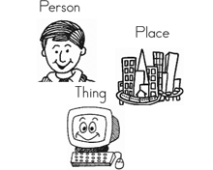
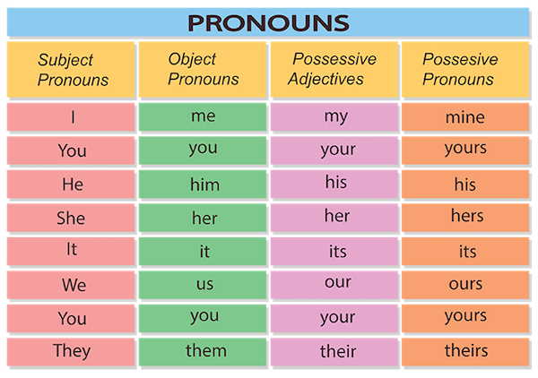
Subject
the subject is the part of a sentence or clause that commonly indicates (a) what it is about, or (b) who or what performs the action.
The subject is typically a noun, proper noun, noun phrase, or pronoun).
*noun: person, place or thing
Examples:
Noun: the woman
Proper noun: Megan
Noun phrase: the petite woman
Pronoun: she
(The subject pronouns are I, you, he, she, it, we, they, who, and whoever).

Slide 3
Subjects can be . . .
Noun - dog
Proper Noun - King
Pronoun - he
Noun Phrase – fluffy yellow dog or fluffy American Eskimo mix
Your turn!
Pick a noun to do this with!

Slide 4
Verb
the verb is a part of speech which is used to demonstrate an action or a state of being.
Action verb: ran
Example: I ran fast.
State of being verb: is
Example: She is pretty.

Slide 5
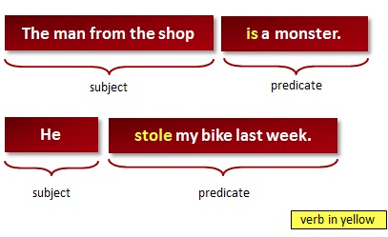
The Basics
Subject: who the sentence is about/performing the action
Verb: action word
Predicate: everything in the sentence other than the subject
At the heart of the predicate is a verb. In addition to the verb, a predicate can contain direct objects, indirect objects, and various kinds of phrases.
A sentence has two parts: the subject and the predicate. The subject is what the sentence is about, and the predicate is a comment about the subject.

Slide 6
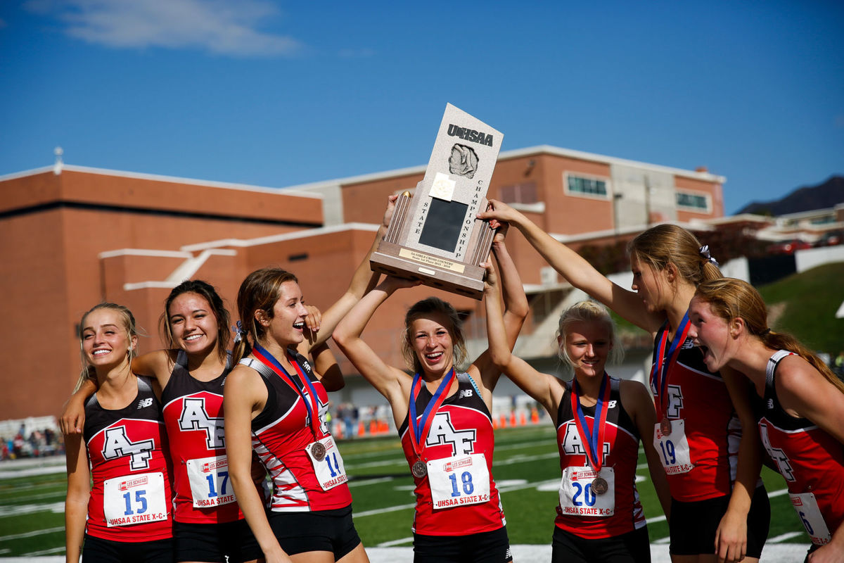
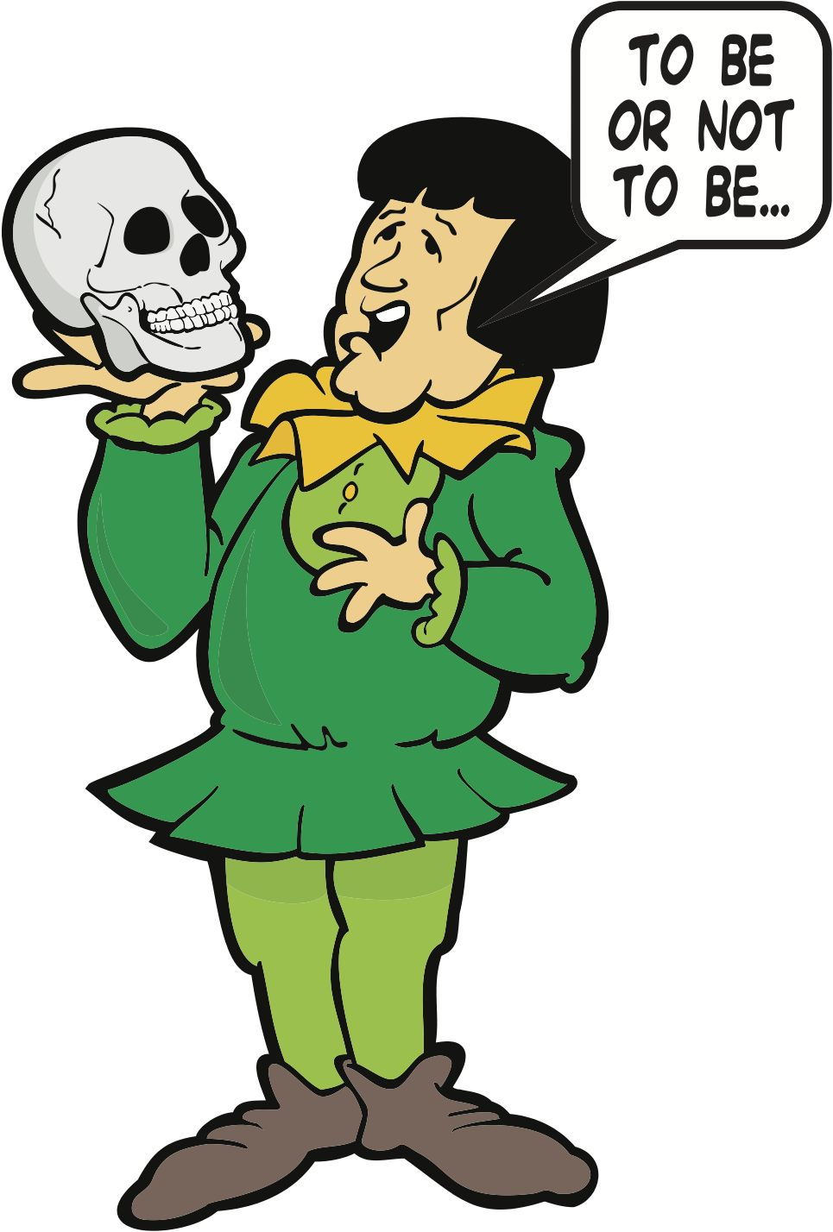
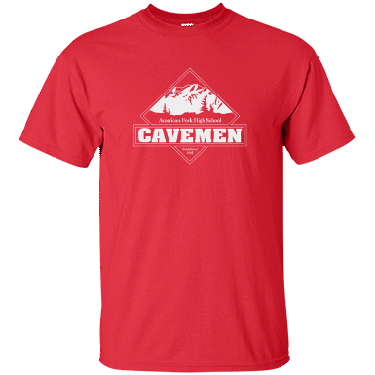
What am I? Subject or verb?
King
they
is
swimming
the bright red shirt
Subject - proper noun
Subject - pronoun
State of being verb
Action verb
Subject – noun phrase
Notes:
Proper noun
Pronoun
Verb
Verb
Noun phrase

Slide 7
Phrase
A phrase is a group of two or more words that does not have the subject and verb combination and does not form a predicate. It can contain a noun or a verb, but does not have a subject or predicate. Essentially, a phrase provides some sort of additional information or provides more context to the sentences you write. A phrase can never stand alone as a sentence.

Slide 8
Clause
A clause is a group of words that can act as a sentence, but is not necessarily a complete sentence on its own. All clauses contain both a subject and a predicate, which always contains a verb.
We will be discussing two types of clauses!

Slide 9
Types of Phrases and Clauses
Types of phrases
Phrases can take many forms and different constructions. They cannot however, ever function as a sentence on their own. The different types of phrases include the following:
Gerund phrases
Infinitive phrases
Noun phrases
Participle phrases
Prepositional phrases
Verb phrases
Types of clauses
The two main types of clauses are independent and dependent. In addition, the following types of clauses are used in constructing sentences:
Adverbial clauses
Defining and non-defining clauses (also called adjective or relative clauses)
Independent and dependent clauses
Noun clauses

Slide 10
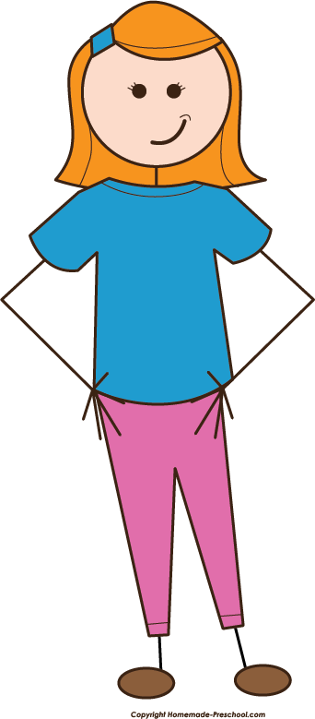
What is an independent clause
An independent clause is:
Clause: (subject + verb)
A clause that can stand by itself and
makes sense by itself.
EXAMPLE: Abigail is intimidating.

Slide 11
Create your own!
Underline the subject
Circle the verb
We are sharing some examples on the board!
In your example you must use the verb: JUMP

Slide 12
Subject & Verb
Anna jumped on the bed.

Slide 13
What is a dependent clause
A dependent clause is:
Clause: (subject + verb) that can’t stand alone. It leaves you wondering.
It needs an independent clause to make sense.
It has a subordinating conjunction.
EXAMPLE: When John got angry at Abigail

Slide 14
Subordinating Conjunctions
Write these down! There are various but here are the most common.
*pass out pink sheet ☺
After | Although | As
Because | Before | If
Since | So that | Than
Though | Unless | Until
Whether | While | What
When | Where | Which
Who | Why | Even though
Even if | Rather than | Whenever

Slide 15
Create your own!
Underline the subject
Circle the verb
Box around the subordinating conjunction
We are sharing some examples on the board!
In your example your subject must be your best friend

Slide 16
Subject, Verb, SC
After Joana ate pizza

Slide 17
4 Types of Sentences
Simple Sentence
Compound Sentence
Complex Sentence
Compound-Complex sentence

Slide 18
Simple Sentence
A simple sentence contains an independent clause that stands alone.
Therefore, it is also an independent clause.
Independent clause = simple sentence.
Example:
Abigail is intimidated by the girls.

Slide 19
Create your own!
Underline the subject
Circle the verb
We are sharing some examples on the board!

Slide 20
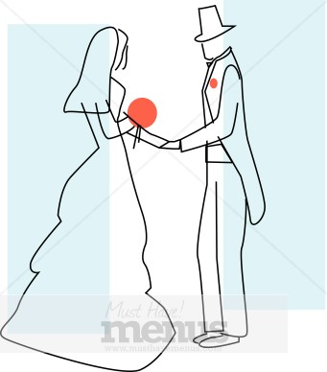
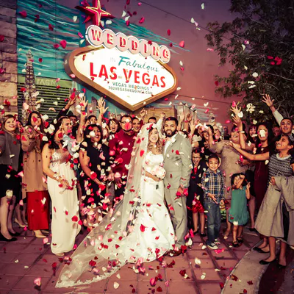
Compound Sentence
A compound sentence contains two independent clauses joined with a coordinating conjunction (FANBOYS) or semicolon.
Coordinating conjunctions:
Comma + For, And, Nor, But, Or, Yet, So
Example:
Abigail loved John, but John didn’t love her.
Abigail loved John; John didn’t love her.

Slide 21
Create your own!
Underline the subject
Circle the verb
Box around the coordinating conjunction (if applicable)
MUST DO BOTH TYPES!
We are sharing some examples on the board!

Slide 22
Complex Sentence
A complex sentence contains one independent clause and one or more dependent clauses.
1- If the dependent clause is in the beginning you need a comma after it.
2- If the dependent clause is at the end you don’t need a comma.
Example:
1- Because Abigail accused her, Tituba got in trouble.
2 -Tituba got in trouble because Abigail accused her.

Slide 23
Examples – On the back of your notes!
DIRECTIONS: For the following examples you will have to identify where the independent/dependent clauses are and swap them/punctuate them appropriately.
EXAMPLE: He loved cooking after he learned how to do it.
I: He loved cooking
D: after he learned how to do it
Rewritten the other possible way: After he learned how to do it, he loved cooking.
When he handed in his homework, he forgot to give the teacher the last page.
The teacher returned the homework after she noticed the error.
The students are studying because they have a test tomorrow.
After they finished studying, Juan and Maria went to the movies.

Slide 24
Create your own!
After | Although | As
Because | Before | If
Since | So that | Than
Though | Unless | Until
Whether | While | What
When | Where | Which
Who | Why | Even though
Even if | Rather than | Whenever
Remember 1 independent and 1 dependent clause
Where do you need to put the comma? (if applicable)
MUST DO BOTH TYPES!

Slide 25
Compound-Complex
A compound-complex sentence is made from two independent clauses and one or more dependent clauses.
a compound sentence and a complex sentence together.
Example: Reverend Parris wanted to be respected, and he wanted to be right since he was the reverend of the town.

Slide 26
Examples – On the back of your notes!
DIRECTIONS: For the following examples you will have to identify where the independent/dependent clauses are.
EXAMPLE: He loved cooking, and he learned how to do it because he didn’t burn anything.
I: He loved cooking
I: he learned how to do it
D: because he didn’t burn anything
1- Though Mitchell prefers watching romantic films, he rented the latest spy thriller, and he enjoyed it very much.
2- Laura forgot her friend's birthday, so she sent her a card when she finally
remembered.
3- The team captain jumped for joy, and the fans cheered because we won the state
championship.

Slide 27
Create your own!
After | Although | As
Because | Before | If
Since | So that | Than
Though | Unless | Until
Whether | While | What
When | Where | Which
Who | Why | Even though
Even if | Rather than | Whenever
Remember 2 independent and at least 1 dependent clause

Slide 28
What sentence is it and why?
Game and candy!
Tell me what type of sentence it is or if it is and why!

Slide 29
What type of sentence?
1. She dropped the pan and the plate, but she held on to the spoon.
2. We have to go to bed when the clock chimes ten o’clock.
3. The bird was sitting on the tree and he was eating his food, but then he fell.
4. Juan went to school, but Susy remained at home because she had a sore throat.
5. Before we can go to the party, we have to clean.
6. I ran fast, and she did too.
Notes:
1.COMPOUND
2.COMPLEX
3.COMPOUND-COMPLEX
4.COMPOUND-COMPLEX
5.COMPLEX
6. COMPOUND

Slide 31
Appositive Phrase
Appositive is a noun or pronoun placed close to another noun or pronoun to identify that word or provide more information about it. An appositive with its modifiers is called an appositive phrase.
Essential: an appositive phrase that is needed to make the meaning of a sentence clear. NO COMMAS needed.
Example: The hero Beowulf defeated the Swedes in battle.
Nonessential: an appositive phrase that simply adds information to a sentence whose meaning is already clear. NEEDS COMMAS.
Example: Beowulf, who was strong, defeated the Swedes.
Notes:
Pronouns: I, me, mine, myself, she, her, hers, herself, we us, ours, ourselves.

Slide 32
Appositive – Essential or non essential
1. My cousin, a doctor, is going to join the peace corps.
2. My friend Jennifer is never late.
3. My sister Stephanie just bought a big house.
4. Evan, one of my roommates, is in the army.
5. My roommate Evan is in the army.
6. John lost his dog, a small black lab, at the late.

Slide 33
Possession
Demonstrates belonging.
Possession using ‘s
Possession using of
Possession using possessive pronouns

Slide 34
Possession with an of
Using “of” to show possession.
The honor of Beowulf was great.
The courage of Wiglaf helped Beowulf.
The treasure of the dragon . . .

Slide 35
Possession with an ‘s
Showing possession using ‘s
EXAMPLE:
The honor of Beowulf = Beowulf’s honor
The courage of Wiglaf = Wiglaf’s courage
The treasure of the dragon = The dragon’s treasure

Slide 36
What if the word ends in s?
The house of the Jones family = The Jones’ house
The car of the neighbors = the neighbors’ car
YOU ADD THE ‘ AFTER THE S ONLY.

Slide 37
Possessive Pronouns
Pronouns – rename the noun
EXAMPLE: Luis – he, him
Possessive pronouns take place
of a noun! (Possessive adjectives go
before the noun)
EXAMPLE: It was his sword.
his = referring to Beowulf
Subject | Possessive adjective | Possessive pronouns
I | my | mine
you | your | yours
he | his | his
she | her | hers
it | its | its
we | our | ours
you | your | yours
they | their | theirs

Slide 38
Examples
This is my website vs. This website is mine.
Is that your chair? vs. Is that chair yours?
He is playing his guitar. vs. The guitar is his.
Her hair is red. My hair is brown hers is red.

