Slide 1
Dialogue Activity
Short Stories Unit

Slide 2
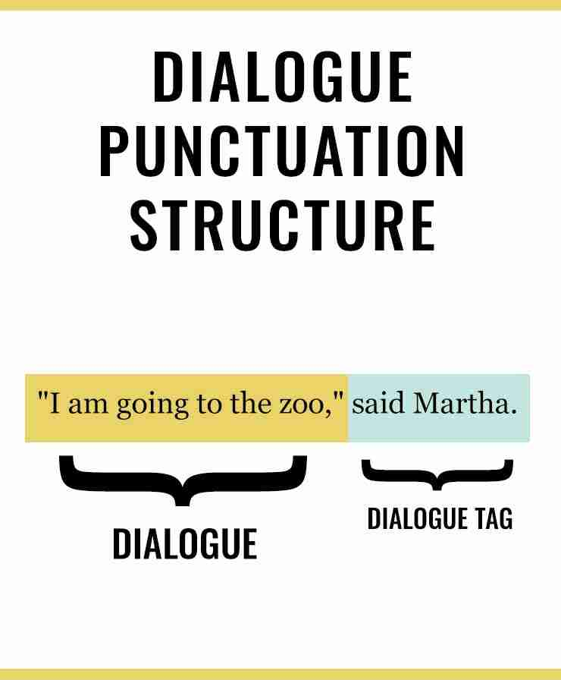
Dialogue
What is it?
How do I punctuate dialogue?
“I don’t like pickles!” he said.
“I don’t like mustard,” she said.
Why do you use it in a story?

Slide 3
Rules to remember . . .
Use quotation marks – to start & end
Add the dialogue tag and if you don’t put the end punctuation inside the quotations.
New paragraph with each new speaker
“For what?” Ben asked.

Slide 4
1.

Slide 5
Example of Dialogue
They sat together on the warm beach looking off into the horizon.
“Have you ever seen anything so beautiful?” David asked Natalia.
“No,” she replied softly.
“It truly is breath taking.”

Slide 6
2.

Slide 7
3.

Slide 8
4.

Slide 9
5.

Slide 10
6.

Slide 11
7.

