Slide 1
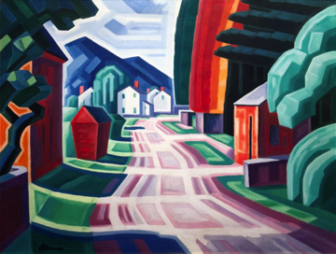
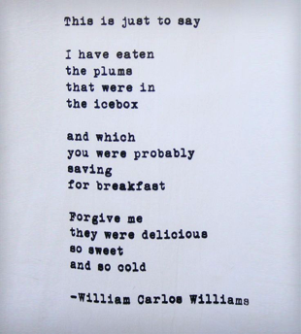
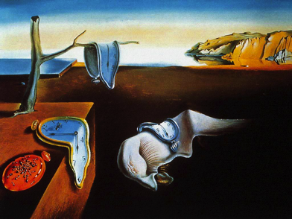
Modernism The Literary Movement

Slide 2
Literary Movements in America
What is a literary movement?
It is an era or time, in America, where literature (as well as other forms of art) reflects social, cultural, and political sentiments of the time. Therefore, each movement has it’s very own characteristics that were influenced by what was going on during that specific time.
These are the literary movements in America:
Native Americans
Puritanism – 1600-1800
Rationalism – 1750-1800
Romanticism – 1800-1855
Transcendentalism – 1840-1855
New Poetic Forms (Romanticism)
Realism – 1865-1915
Harlem Renaissance – 1915-1929
Modernism – 1915-1945
Contemporary 1945- present

Slide 3
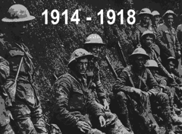
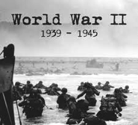
Modernism
Time Period: 1915-1945
What was going on in America during this time?
World War I
The Great Depression
World War II
Prohibition
The Roaring 20’s
Women Voting Rights
Characteristics of the time period:
1. Sense of disillusionment and loss of faith in the “American Dream( that the independent, self-reliant, individual will triump)”.
2. Emphasis on bold experimentation in style and form over the traditional form.
3. Interest in the inner workings of the human mind (ex. stream of consciousness).
Stream of consciousness: aims to express in words the flow of the character’s thoughts and feelings in their minds. It is to give the readers the impression of being inside the mind of the character and as a result being inside the mind of the character sheds light on plot and motivation in the novel.
4. Taboo subject matter

Slide 4
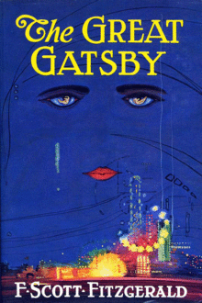
Intro to The Great Gatsby by F. Scott Fitzgerald

Slide 5
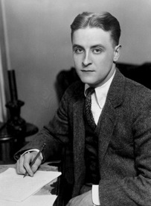
Who was F. Scott Fitzgerald?
Born September 24, 1896 in Minnesota
Didn’t do well in school and enlisted in the army at the end of WWI
In Alabama he met and fell in love with a 17 year old girl named Zelda Sayre.
She agreed to marry him but because she was interested in money and having fun and she delayed the wedding until he could prove his success.
In 1920, he sold books and attained money
and fame so they got married.
Battled alcoholism
Died of a heart attack at the age of 44.

Slide 6
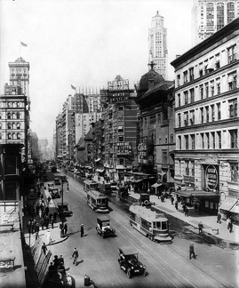
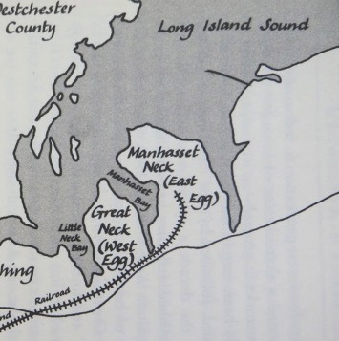
The Novel
Written/published in 1925
Some of Fitzgerald’s life events actually appear in The Great Gatsby.
Set in 1922 - in New York City

Slide 7
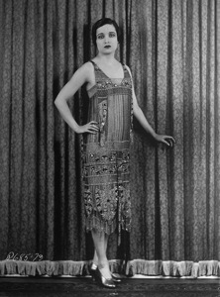
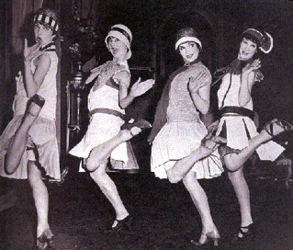
The 1920’s – Roaring 20’s
End of the Great War – WWI (1914-1918)
Time of prosperity
Prohibition – no selling/consuming alcohol
In 1920, after 72 years of struggle, American women received the right to vote. After the 19th Amendment passed, reformers talked about female voters uniting to clean up politics, improve society, and end discrimination.
Flappers

