Slide 1
Modernism in Other Forms

Slide 2
Literature
The Great Gatsby by F. Scott Fitzgerald
We are going to be reading it this unit and looking at how the 4 characteristics of modernism appear throughout it.
1. Sense of disillusionment and loss of faith in the “American Dream( that the independent, self-reliant, individual will triump)”.
2. Emphasis on bold experimentation in style and form over the traditional form.
3. Interest in the inner workings of the human mind (ex. stream of consciousness).
4. Taboo subject matter

Slide 3
Art
What was the artwork like?
  bright colors
  abstract art
  Impressionist, cubist art from Europe influenced American artists that saw those things as new and radical ideas.
  New techniques
  Shined light on emotional and psychic states of the audience
  Focused on pointing out social issues

Slide 4
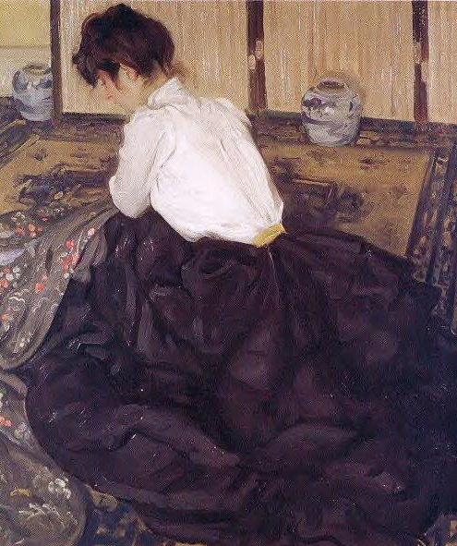
Before: Alfred Henry Maurer, An Arrangement 1901
Notes:
REALIS

Slide 5

Morgan Russell, Cosmic Synchromy (1913-14)

Slide 6
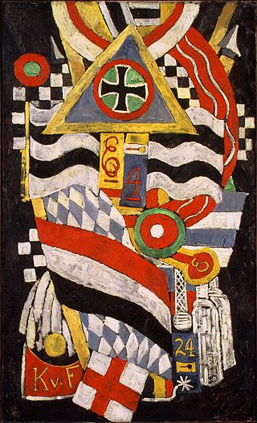
Marsden Hartley, Portrait of a German Officer, 1914

Slide 7
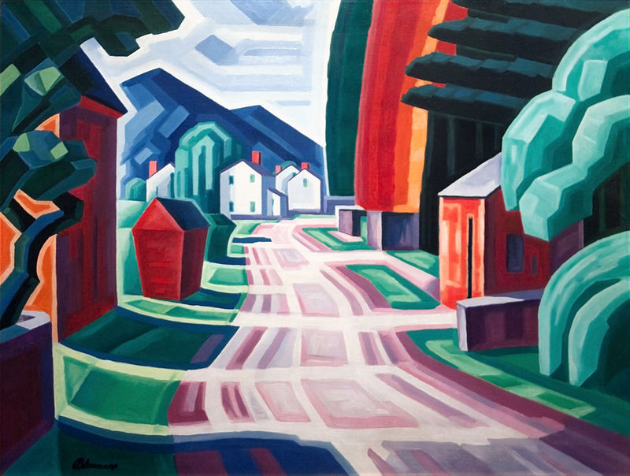
Oscar Bluemner, Form and Light, Motif in West New Jersey (1914)

Slide 8
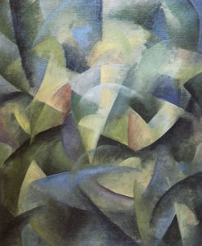
Andrew Dasburg, Improvisation , 1915-16

Slide 9
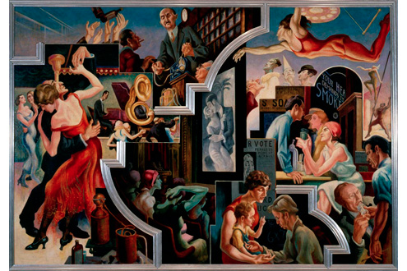
Thomas Hart Benton, America Today, 1930-31

Slide 10
Songs
This video showcases the Jazz Age of the 1920s. It was the music that was popular during modernism.
Because modernism was from 1915-1945, the Harlem Renaissance (1915-1929) fell into the modernism time period. As a result, jazz influenced modernist works as well.
https://www.youtube.com/watch?v=48jUyAK_4Uo

Slide 11
Groups
1. Landscape with the Fall of Icarus -WCW
2. in just – EC
3. “Out, Out –” RF
4. The Road Not Taken - RF

Slide 12
Poetry
In groups you will each be responsible for looking at a modernist poem from a modernist author.
You will have to do following:
  1. Read the poem.
  2. What is the poem about?
  3. What modern theme(s) are present in the poem and how do you know? Find at least 2 examples.
  4. How does it remind you of the modern music/art we have talked about today in class?
  BE PREPARED TO SHARE THIS INFORMATION WITH THE CLASS!

