Slide 1
Ted Talks
English 11

Slide 2
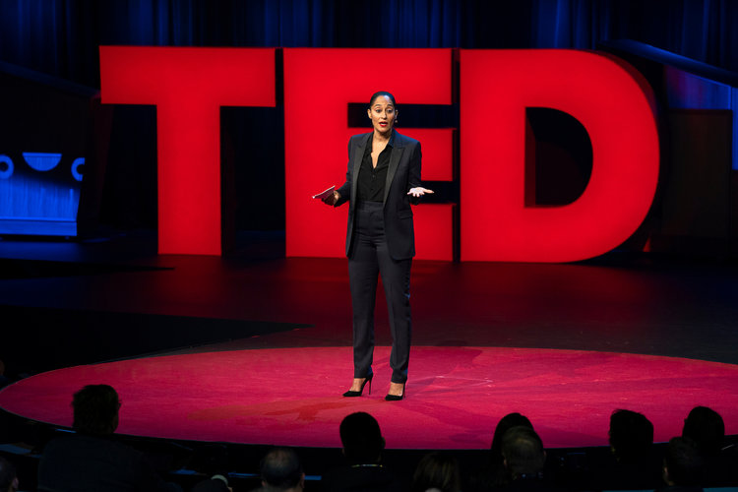
What is a Ted Talk?
A TED talk is a presentation at the main TED (technology, entertainment, design) conference or one of its many satellite events around the world. TED talks are limited to a maximum length of 18 minutes and may be on any topic.

Slide 3
Key Elements of a Ted Talk
They are timed.
They present on a topic of choice (claim/thesis).
They provide research based information (establishes credibility).
They have visuals.
They are well executed and planned out.
They are interesting/entertaining.
They are well organized.
Hook
Research
Conclusion

Slide 4
Presenting your research
During Term 2 you did research and wrote a research paper on a topic of your choice. Now it is time to present your findings to the class.
The best part of this assignment is that some of the work is already done!
RESEARCH = done!
Because your research paper was designed to be a learning paper – you are going to be sharing what you learned about your topic via your very own TED TALK presentation!

Slide 5
Ted Talk Planning Guide (Assignment Sheet)
Ted Talk Planning Guide due: January 10th (B)
Ted Talk Rehearsal Sheet due:
½ due (5 audiences): January 14th (B)
½ due (5 audiences): January 16th (B)
Final presentations are January 18th and January 22nd in class!
Winners will get extra credit/treat and participate in our TED Talk Expo with other classes!

Slide 6
BUT FIRST . . . What does a good TED Talk look like?
As you watch the following Ted Talks you must take notes on what made them successful!
Be VERY SPECIFIC. It will help you when you are planning your own TED Talk!
Answer the following:
What was the Ted Talk topic/claim?
What kind of hook did it have?
What was the conclusion like?
How was the research presented?
Other aspects that made it successful?

Slide 7
Ted Talk #1: “Why Bother Leaving the House?” Ben Saunders
https://www.ted.com/talks/ben_saunders_why_bother_leaving_the_house (10:24)
Topic: Why do we explore when we can see everything online? Get out and LIVE!
Great pictures!
Notes
Personal experiences
Cites multiple sources

Slide 8
Note: only had time for one Ted Talk and discussion of it

Slide 9
Ted Talk #2: “What I learned from 100 days of rejection” Jia Jiang
https://ed.ted.com/featured/VdQTGGdx#review (15:59)
Topic: Rejection
Humor
Personal experiences
Shows evidence

