Slide 1
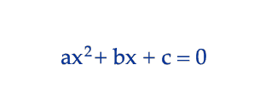
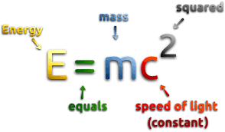
The Thesis Formula
In-class notes

Slide 2
What is a thesis?
A thesis is:
What the entire essay is going to be about.
Roadmap that tells the readers what they are about to read.
Thesis statements need to be CLEAR AND SPECIFIC, need to STATE AN OPINION, and be ONE COMPLETE SENTENCE.
Remember: don’t use I because it is in the third person!

Slide 3
Why do we need a formula?
It helps you know what you need every single time to create a strong thesis.
As long as you follow the steps of the formula you will have a good thesis statement.

Slide 4
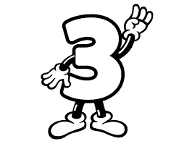
The formula
You need 3 things for the thesis formula:
Topic/Prompt
Opinion
3 reasons why you have that opinion

Slide 5
The formula
TOPIC/PROMPT + OPINION + WHY(3)= THESIS

Slide 6
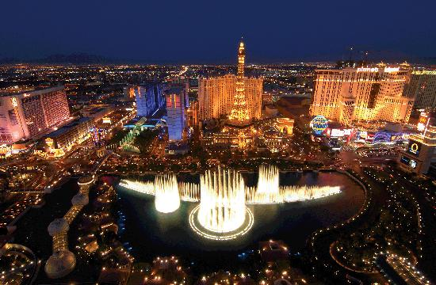
Example
TOPIC/PROMPT + OPINION + WHY(3)= THESIS
Thesis: The best vacation spot in the US is Las Vegas because of the shows and attractions, the nice weather year round, and its affordability.
TOPIC/PROMPT: Best vacation spot in the US (United States)
OPINION: I think Vegas is the best vacation spot in the US.
WHY: Come up with 3 subclaims (3 points) to back up your opinion
Shows and attractions
Nice weather all year
Affordable (not super expensive)

Slide 7
Practice
Topic/prompt: the best hobby
Opinion: I think . . .
Why (3): 1, 2, 3 reasons
The best hobby is swimming because it is it’s an individual sport, it’s inexpensive, and it’s a good workout.

Slide 8
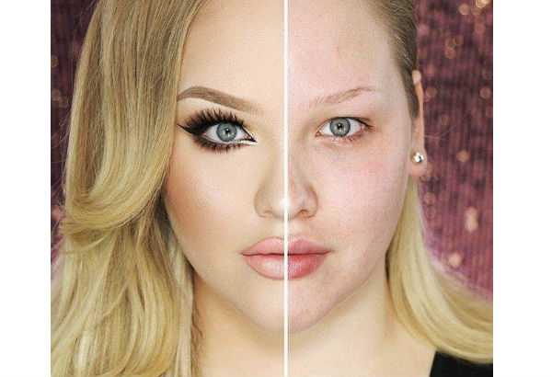
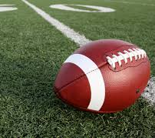
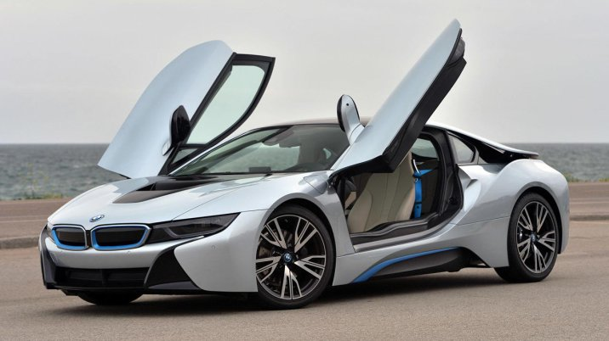
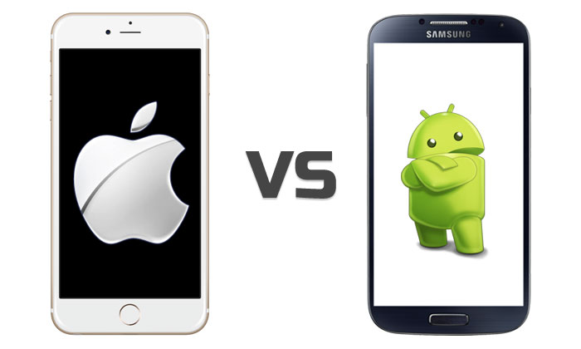
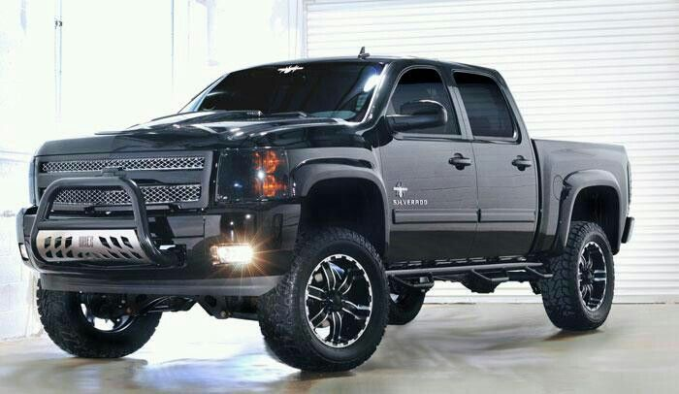
Your turn
Pick a topic:
1. Soccer or Football
2. Car or Truck
3. Makeup or no makeup
4. iPhone or Android

Slide 9
Make a thesis
After you have picked your topic create a thesis statement.
Remember you need to have: A topic/prompt + your opinion + 3 subclaims why you have that opinion = thesis statement
Pick a topic:
1. Soccer or Football
2. Car or Truck
3. Makeup or no makeup
4. iPhone or Android

Slide 10
Topic Sentences
How many topic sentences do you need if you have three reasons?
If you have two reasons?
What are topic sentences?
Mini thesis statements for your paragraph.
They tell the reader what the entire paragraph will be about.
How do you know what to write down?
They are the same as your subclaims ☺

Slide 11
Today
You will be getting your thesis assignment that goes with The Crucible Act I.
When you are finished with it you will need to check it off with Mrs. Reyes.
Check off notes and also pink paper! ☺

