Slide 1
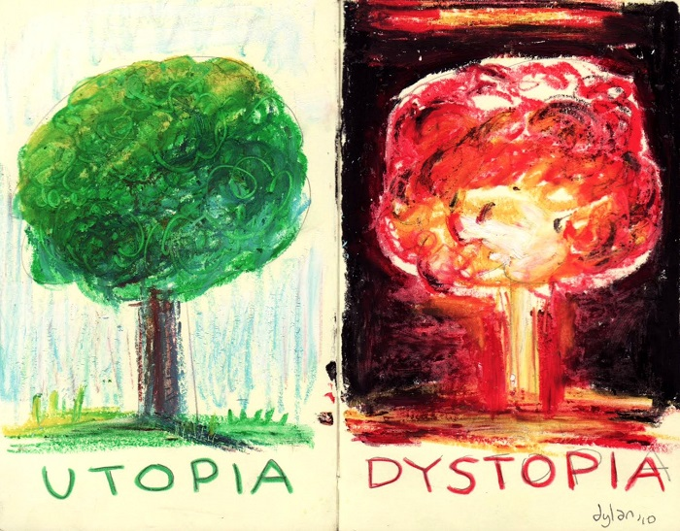
Utopia and Dystopia
What are they?

Slide 2
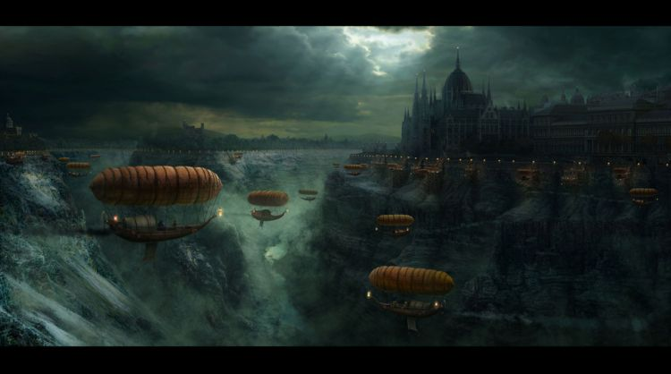
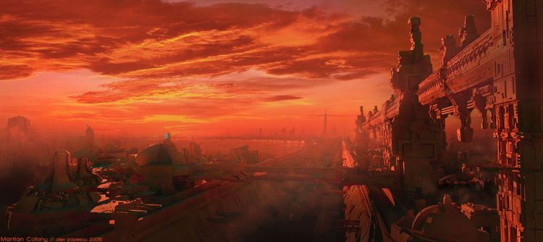
Similarities
Type of world that is popular in science fiction, horror, supernatural, apocalyptic, alternative history, or other type of fiction that is not strictly realistic.

Slide 3
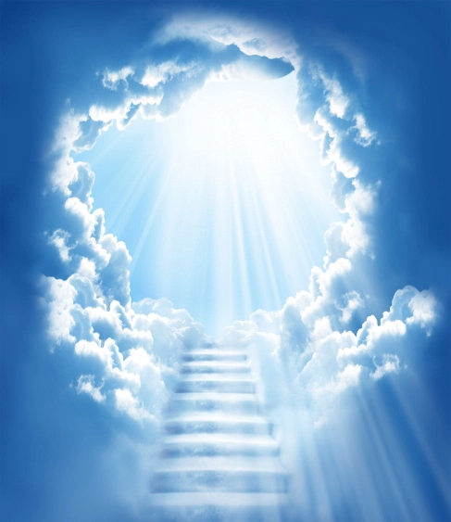
Utopia
A perfect world!
Lacking war, disease, poverty, oppression, inequality and so forth.
A world that is free of conflict.
Example: Heaven

Slide 4
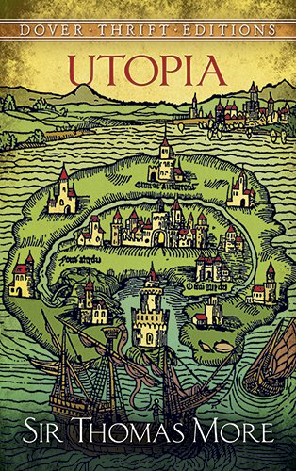
The word Utopia. . .
Greek word
Word comes from Sir Thomas More (1478-1535)
1516 he wrote the book, “UTOPIA”
It means both “no place” and “good place”

Slide 5
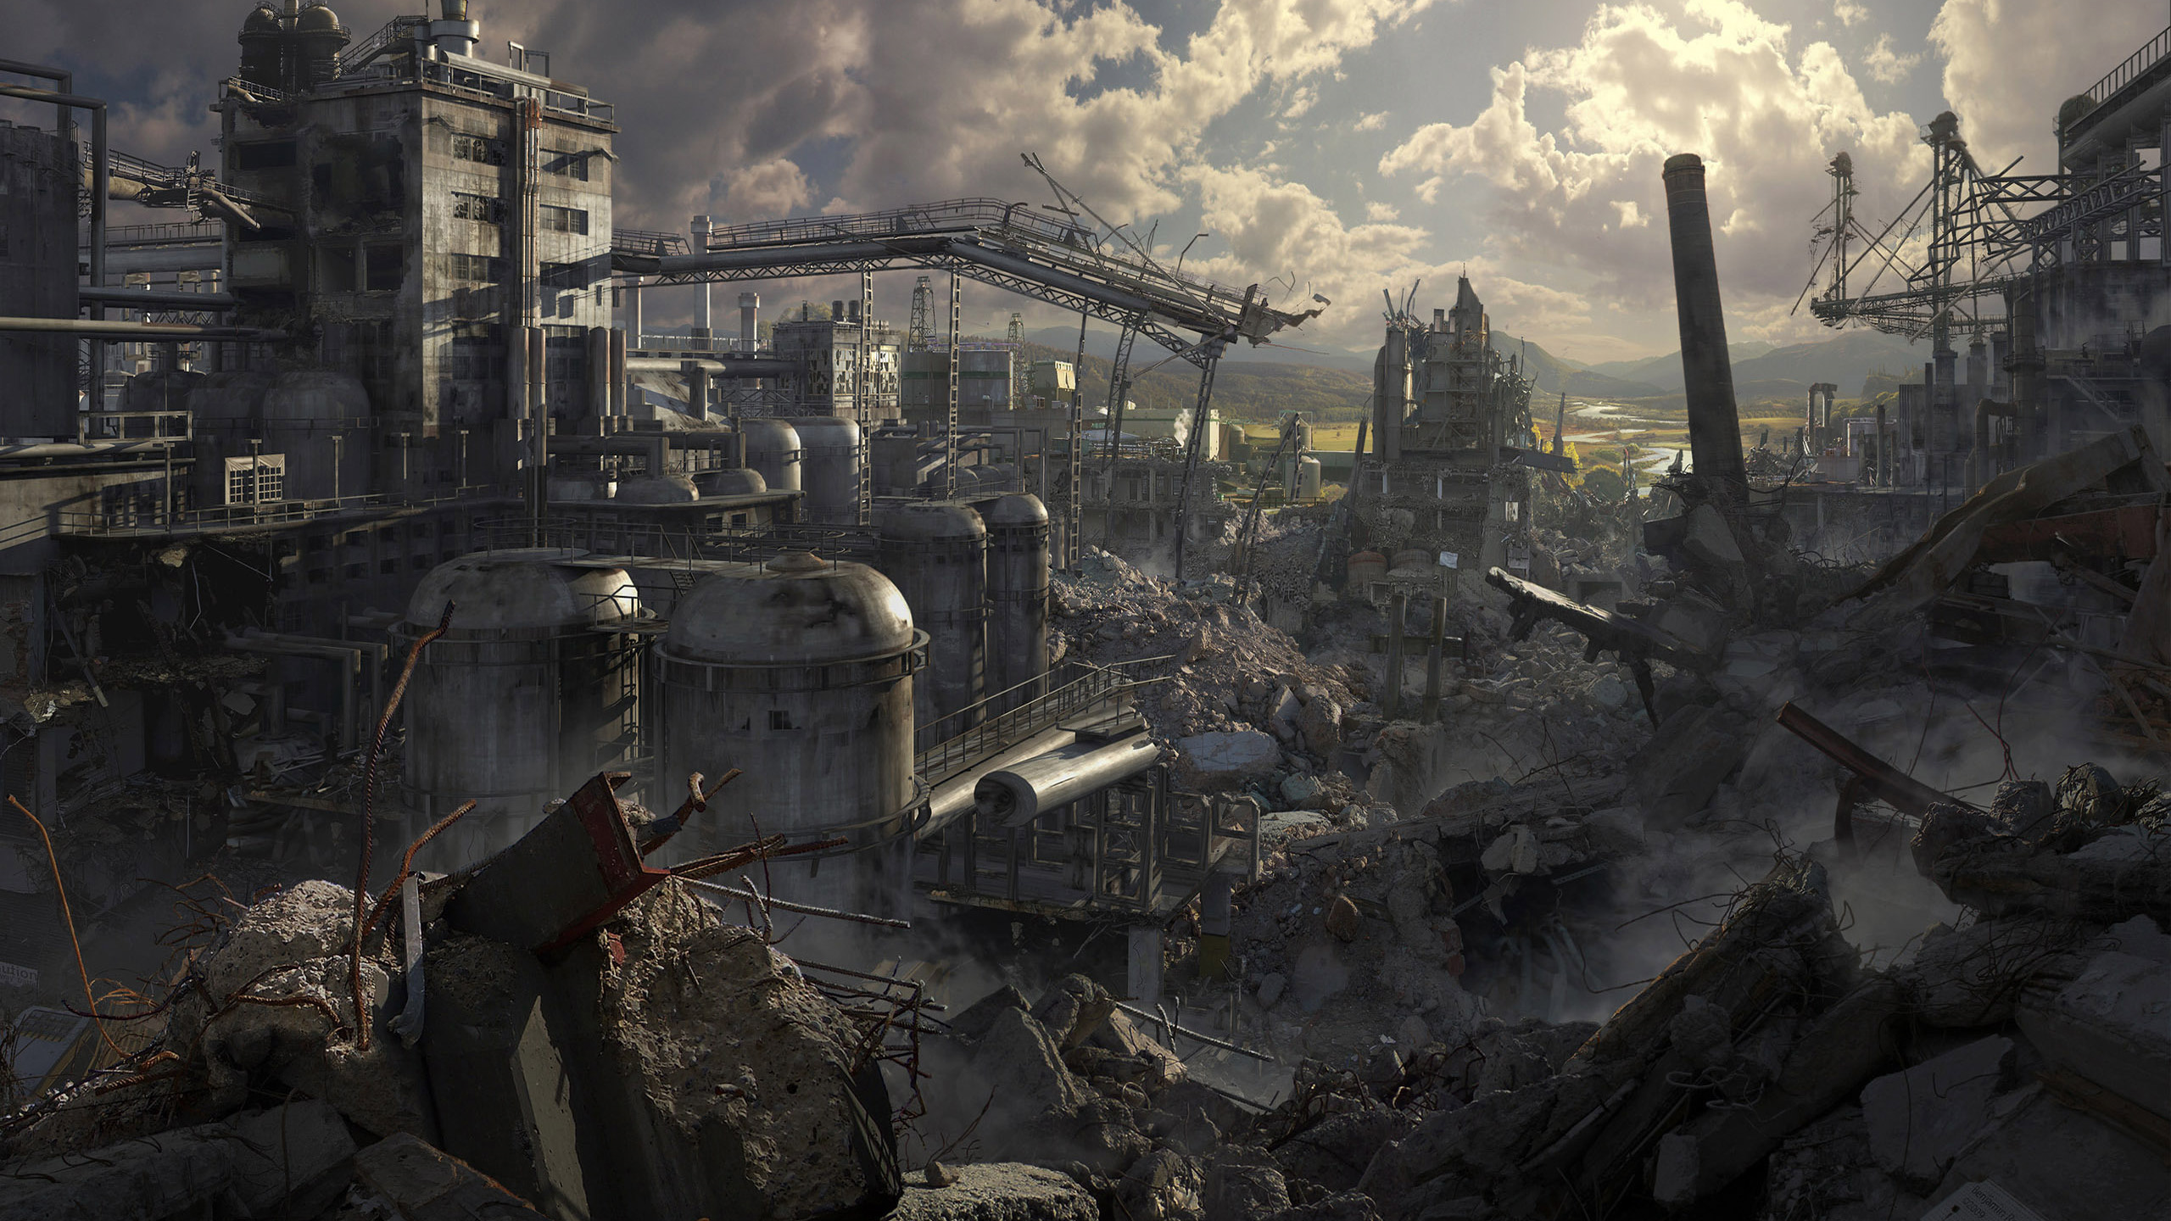
Dystopia
An illusion of a perfect society/world.
But in reality it is a world where nothing is perfect.
Problems are often extreme.
Dystopias usually make a criticism about a current trend, social norm, or political system.
Example: Nazi Germany, The Capital (Hunger Games)

Slide 6
The word Dystopia
Play on utopia
Added prefix of dys – which means “bad” or “difficult”
Dystopias are common with writers because:
It is intriguing to think up solutions to our world’s problems
Dystopias are full of conflict – something that is vital to good stories!

Slide 7
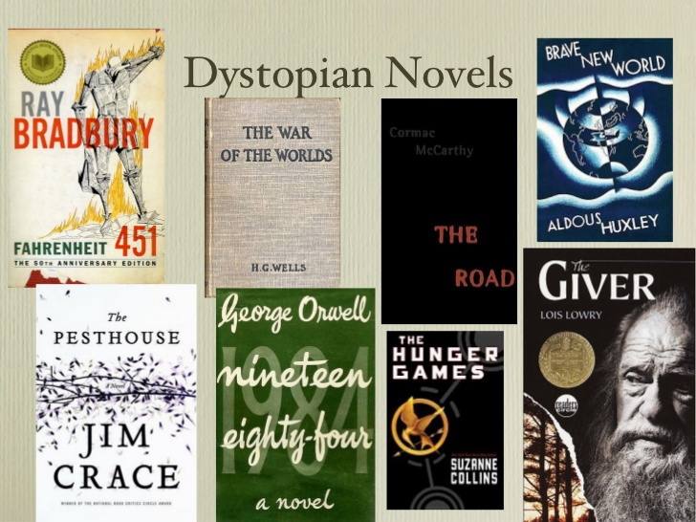

Slide 8
Characteristics of a Dystopian Society
Controlling, oppressive government
Propaganda is used to control the citizens of a society
Information, independent thought , and freedom are restricted
A figurehead or concept is worshipped by the citizens of the society
Citizens are perceived to be under constant surveillance

Slide 9
Characteristics of a Dystopian Society
Citizens have a fear of the outside world
The natural world is banished and distrusted
Citizens conform to uniform expectations. Individuality and dissent are bad
The society is an illusion of a perfect utopian world

Slide 10
A Modest Proposal – Jonathan Swift
As we read this short excerpt . . .
http://art-bin.com/art/omodest.html
Tell me what the problem is in the society.
What is the proposal to fix that problem?
Is it a dystopia or utopia? How do you know?

Slide 11
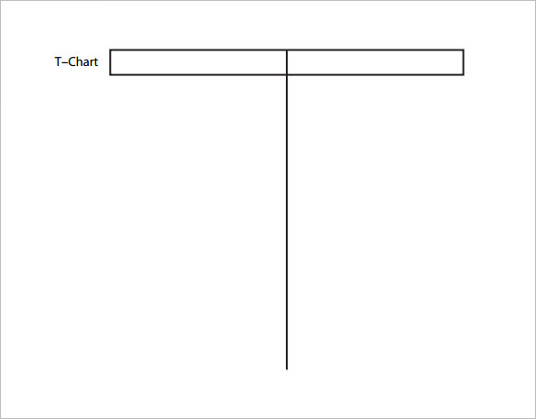
Video Examples
Make a T Chart in your notes.
On one side label it Dystopia
Tell me how the clip(s) we watch are dystopian
https://www.youtube.com/watch?v=mfmrPu43DF8\
On the other label it Utopia
Tell me how the clip(s) we watch are utopian
https://www.youtube.com/watch?v=ut0ai4s4mjU

Slide 12
(Show 10 min of each or something) The Giver or The Lego Movie TV Show- Twilight Zone vs. The Good Place

Slide 13
We will be reading dystopian novels in book clubs. You will get to choose which novel you read! ☺

