Slide 1
Short Story Assessment Review
A Day – TEST on Sep. 28
B Day – TEST on Sep. 29

Slide 2
Short Stories we’ve read . . .
Wish for Wings that Work
The Lottery
A Rose for Emily
To Build a Fire
Cask of Amontillado
Red Room
Walter Mitty

Slide 3
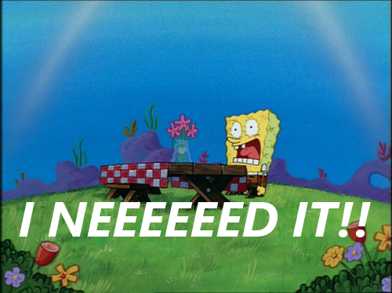
What is a literary element?

Slide 4
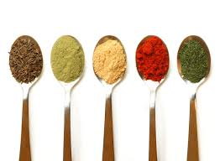
What is a literary device?

Slide 5
Give me the list of elements and the list of devices

Slide 6
Draw a plot and label the parts

Slide 7
Do the plot diagram for one of the short stories we have read

Slide 8
What are the 6 types of conflicts?

Slide 9
Tell me the conflict and the type of conflict in “To Build a Fire”

Slide 10
What 3 things do you need to state when talking about setting in a story?

Slide 11
What is the setting in “Cask of Amontillado?”

Slide 12
Tell me the three point of views and their key words

Slide 13
What is the point of view in . . .
The Red Room
Cask of Amontillado
To Build a Fire
A Rose for Emily

Slide 14
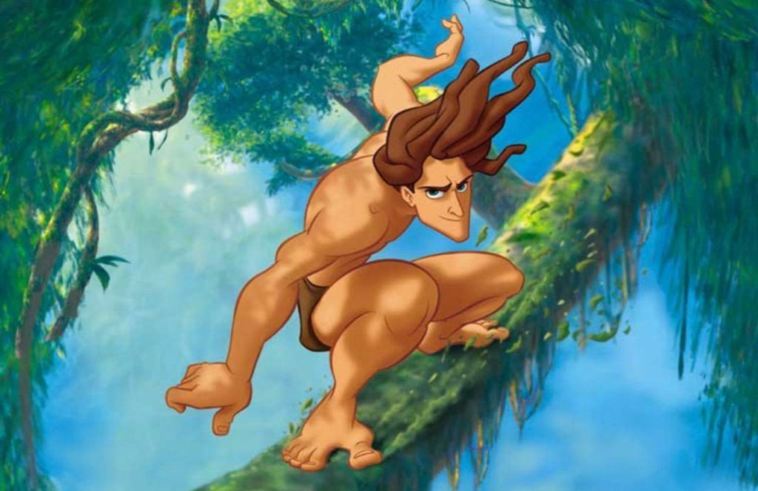
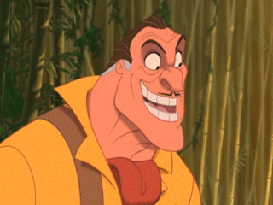
Who is the protagonist and antagonist in the following stories. . .
The Lottery
Walter Mitty
To Build a Fire
The Red Room

Slide 15
Define theme

Slide 16
What was the theme of one of the stories we read?
Explain what the theme is and how you know.

Slide 17
Define imagery

Slide 18
Using imagery describe this item

Slide 19
Define simile and metaphor

Slide 20
Create a simile and a metaphor

Slide 21
Define symbolism

Slide 22
Give me 3 examples of symbols in real life

Slide 23
Tell me what these symbols meant in the stories we read
To Build a Fire
Fire
Dog
Man
Cask of Amontillado
Serpent
Catacombs
Fortunato
Jester costume

Slide 24
Define irony

Slide 25
Tell me the 3 types of irony and their definitions

Slide 26
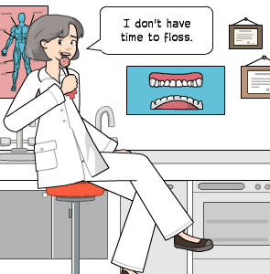
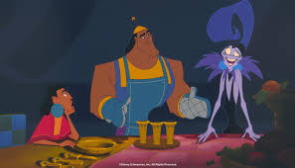
Tell me what type of irony this is
Example: I went to the dentist and she told me I have to floss more often. I told her I don’t have time to, and she said she understood because neither did she.
Example: “Great someone stained my new dress.”
Example: Yzma invites Kuzco to dinner where she plans to turn him into a llama.

Slide 27
Define tone

Slide 28
Tell me the tone of the following statements
Sincere:
1. She rose from her chair when I came in and exclaimed with a smile: “Wow! You look so pretty today! I love the outfit.”
Sarcastic:
2. She looked at me from head to toe and said with a short laugh, “Yeah, right! Nice outfit.”
Envious:
3. She glanced at me quickly and muttered reluctantly, “Um, yeah . . . Your outfit looks okay, but honestly you could use some pointers.”
Insulting:
4. She looked at me incredulously and said, “Eww! Nice try with your outfit. Ha!

Slide 29
Tell me the tone of . . .
The Lottery
Cask of Amontillado
Wish for Wings that Work
Red Room

Slide 30
Remember to . . .
STUDY YOUR PINK NOTE SHEET
STUDY THE STORIES WE HAVE READ
STUDY THIS PPT (it is on my website!)

