Slide 1
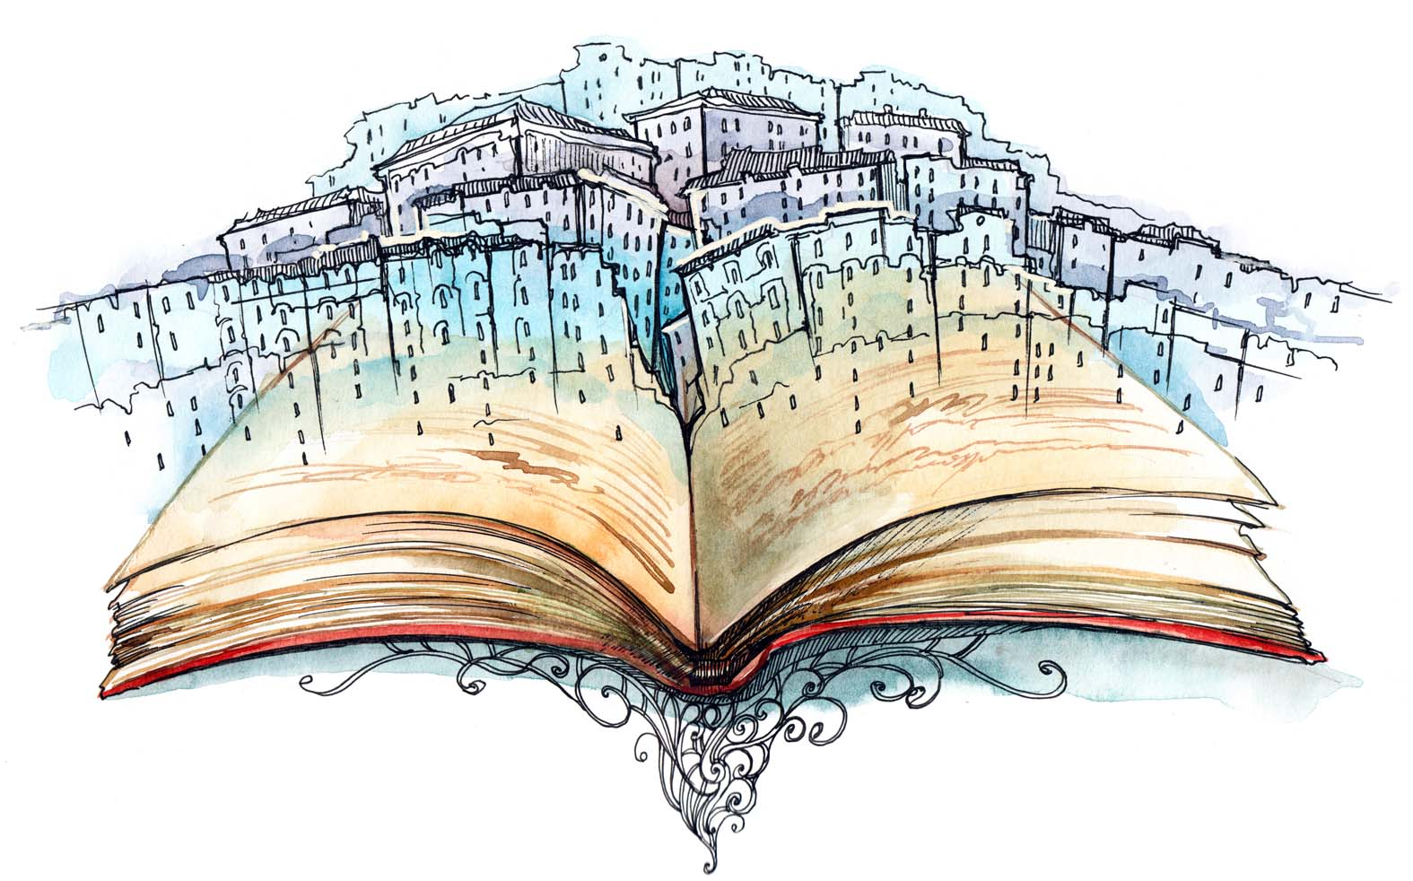
Short Story
Elements & Devices

Slide 2
What is a short story?
A short story is: a brief work of fiction where, usually, the main character faces a conflict that is worked out in the plot of the story.

Slide 3
SHORT STORY ELEMENTS
Definition: Short story elements are ESSENTIAL to the story.
You need to have them!
Plot
Conflict
Setting
Point of View
Character
Theme

Slide 4
#1.PLOT
The plot is a series of related events that make up a story.

Slide 5
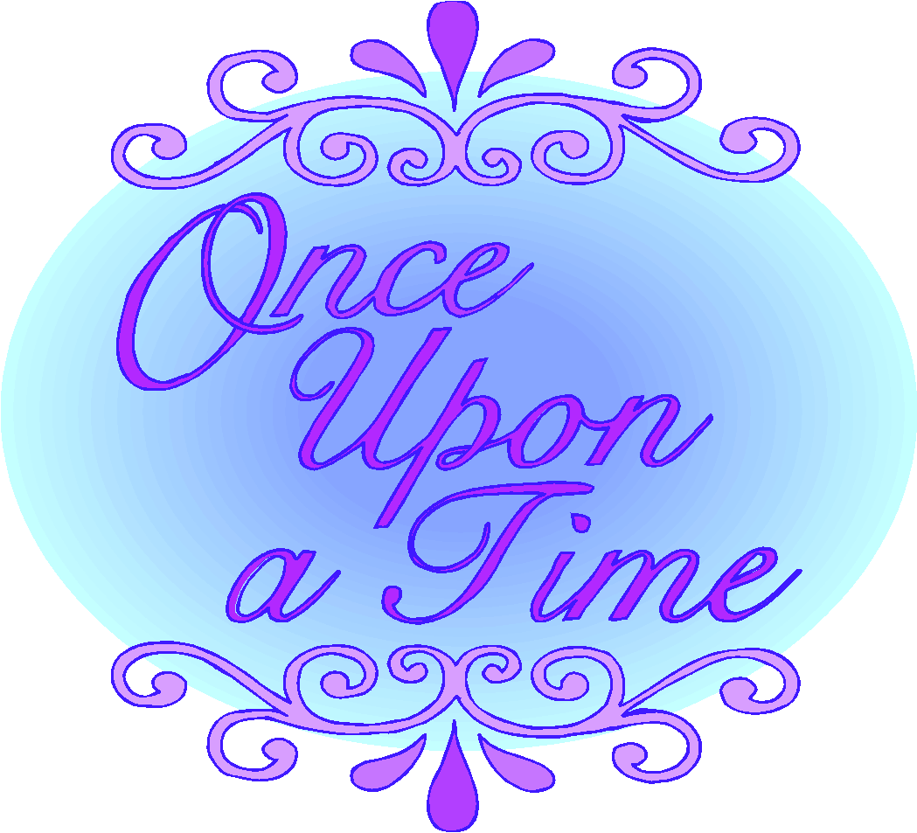
Exposition
Designed to catch the reader’s interest
Background is provided
Introduces characters & setting

Slide 6
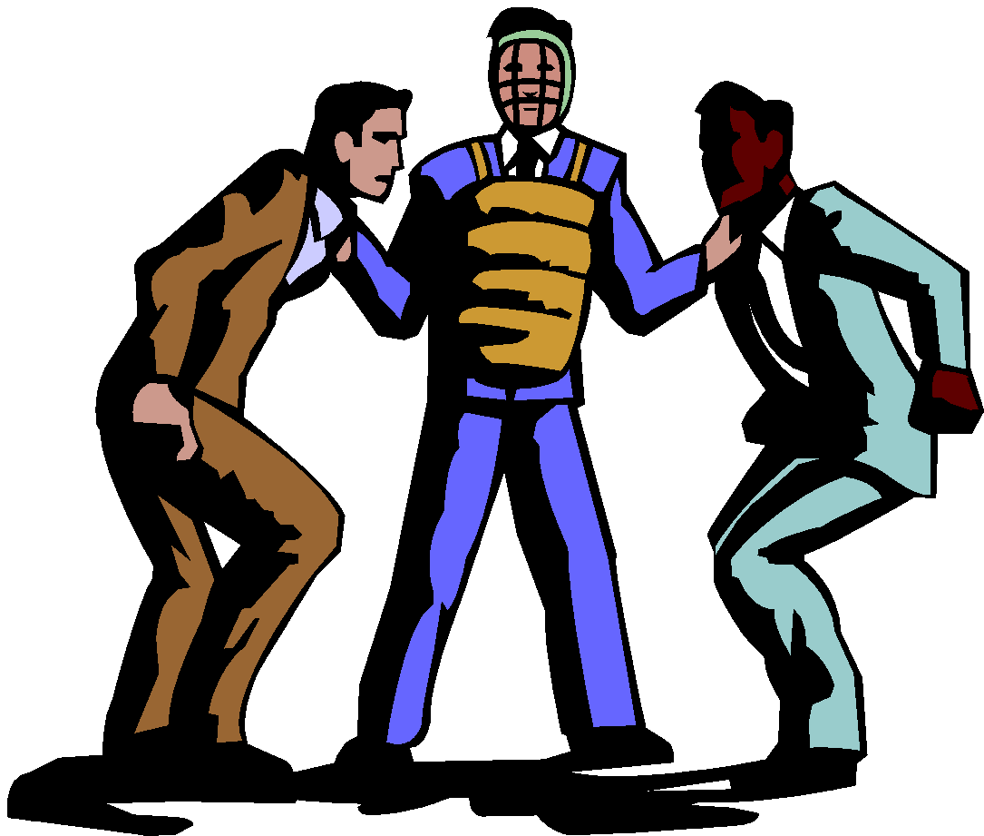
#2. CONFLICT
A struggle between two opposing forces
2 Types:
Internal – takes place in a character’s own mind
Man vs. Him(Her)self
External – a character struggles against an outside force
Man vs. Man
Man vs. Nature
Man vs. Technology, Progress
Man vs. Society
Man vs. Supernatural

Slide 7
Rising Action
Consists of a series of complications.
These occur when the main characters take action to resolve their problems and are met with further problems.
Examples:
Fear
Hostility
Threatening situation

Slide 8
Climax
The turning point in the story: the high point of interest and suspense
Climax
Rising Action or Complications
Falling Action

Slide 9
Falling Action
All events following the climax. These events are a result of the action taken at the climax and they lead to the resolution.

Slide 10
Resolution
(Denoument)
The end of the central conflict: it shows how the situation turns out and ties up loose ends.

Slide 11
#3. SETTING
The time and place and duration of the story.

Slide 12
#4. POINT OF VIEW
Vantage point from which the writer tells the story.
First person- One of the characters is actually telling the story using the pronoun “I”
Second person- Narrator addresses the reader (usually not used in fiction). Usually instructions using “your” and an understood “you”
Third person- Author tells the story.
Tells others’ stories using “he,” “she” and characters’ names

Slide 13
#5. CHARACTER
Character – a person in a story, poem or play.

Slide 14
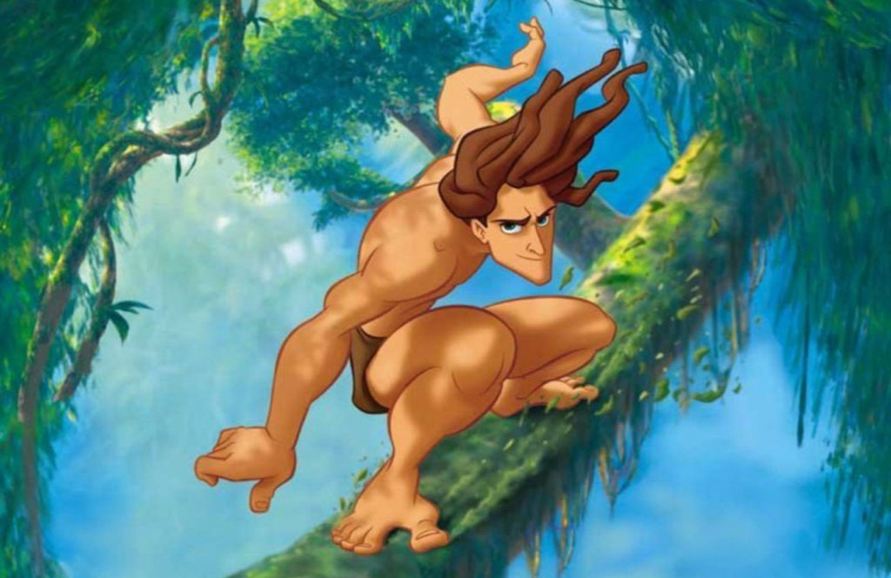
Protagonist
Main character of the story that changes
(death is not a change)
the most important character
changes and grows because of experiences in the story

Slide 15
Antagonist
A major character who opposes the protagonist
the antagonist does not change
Types of antagonists:
people
nature
society

Slide 16
Characterization
Direct characterization
The author directly states what the character’s personality is like. Example: cruel, kind
Indirect characterization
Showing a character’s personality through his/her actions, thoughts, feelings, words, appearance or other character’s observations or reactions

Slide 17
5 methods of Characterization
How the author develops the characters, especially the main character.
This is done through: (STEAL)
Speech: what the character does or says
Thoughts: what is revealed through the character’s private thoughts
Effect on others: what others say of and to the character
Actions: What does the character do? How do he/she behave?
Looks: What does the character look like?

Slide 18
#6.THEME
The central message or insight into life revealed through a literary work. Also known as the “main idea” of the story.
IT IS A COMPLETE SENTENCE not simply a word.

Slide 19
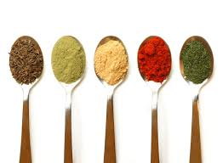
LITERARY DEVICES
Definition: Literary devices add/enhance your writing. Basically they add flavor to your writing so it isn’t boring.

Slide 20
Imagery
Language that appeals to the five senses.
Touch
Taste
Sight
Sound
Smell
Example:
Creating a picture in the readers mind through description

Slide 21
Symbol
An object, person, or event that functions as itself, but also stands for something more than itself.
Example: Scales function is to weigh things, but they are also a symbol of our justice system.

Slide 22
Simile
Comparing two unlike things using “like” or “as.”
Examples:
Jason is as small as an ant.
Lily is pretty like a flower.

Slide 23
Metaphor
Comparing two unlike things without using the words “like” or “as.
Examples:
Jim is a ball hog.
Life is a roller coaster, it has lots of ups and downs.

Slide 24
Irony
A contrast between expectation and reality
Verbal Irony – saying one thing but meaning something completely different.
Ex: Calling a clumsy basketball player “Michael Jordan.”
Dramatic Irony – occurs when the reader knows something important that the characters in the story do not know.
Ex: In horror movies, the audience is aware that there is a killer in the house, but the character does not and they enter the house.
Situational Irony – A contradiction between what we expect to happen and what really does happen.
Ex: A teacher failed a test, a pilot with a fear of heights, a marriage counselor filed for divorce.
Notes:
For situational irony to occur there has to be something that leads a person to think a particular event or situation is unlikely to happen.

Slide 25
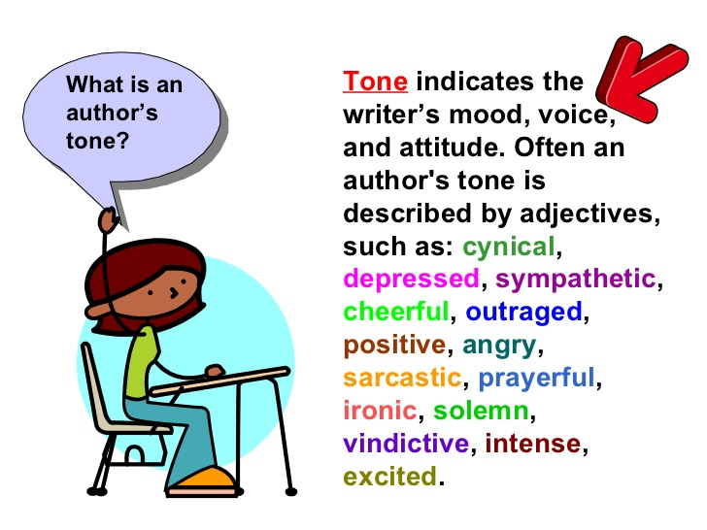
Tone
Tone: an attitude of a writer toward a subject or an audience. Stimulates the reader to read a text in a specific way. (For example: serious, comical, distressing, etc.
Can be found in the story’s: setting, characters, details, and word choices.
Example:
Dad: “We are going on vacation
to Idaho!”
Son: “Greeeaaat.”

